Slide 1
Admin to Control Restaurant Template Admin Controls All The Templates

Slide 2
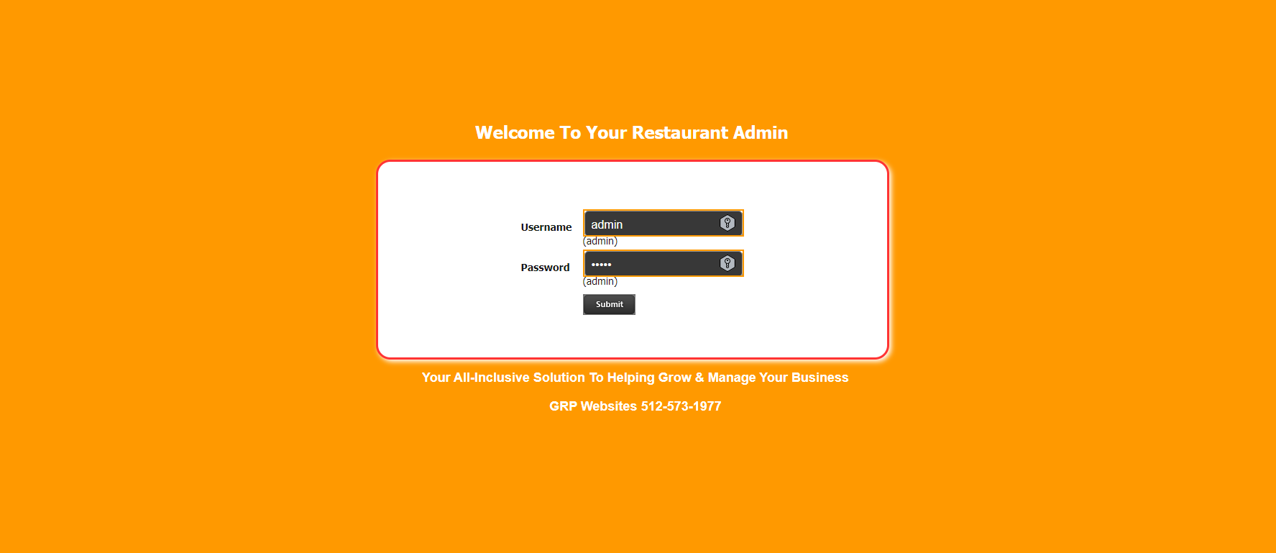
Login To Admin Section

Slide 3
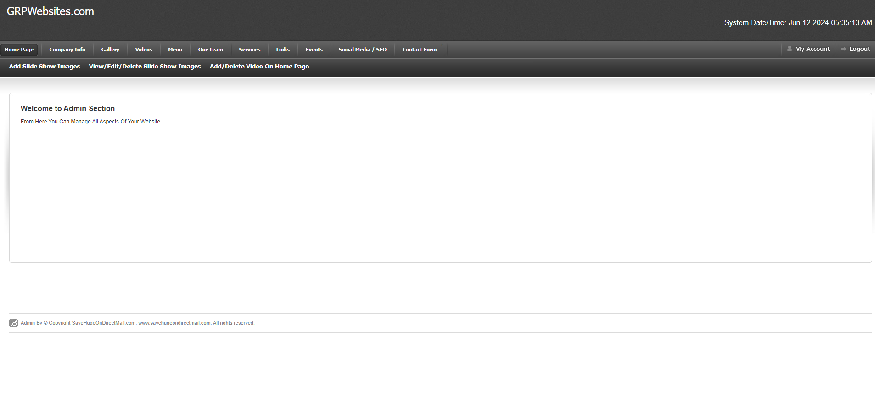
Dashboard

Slide 4
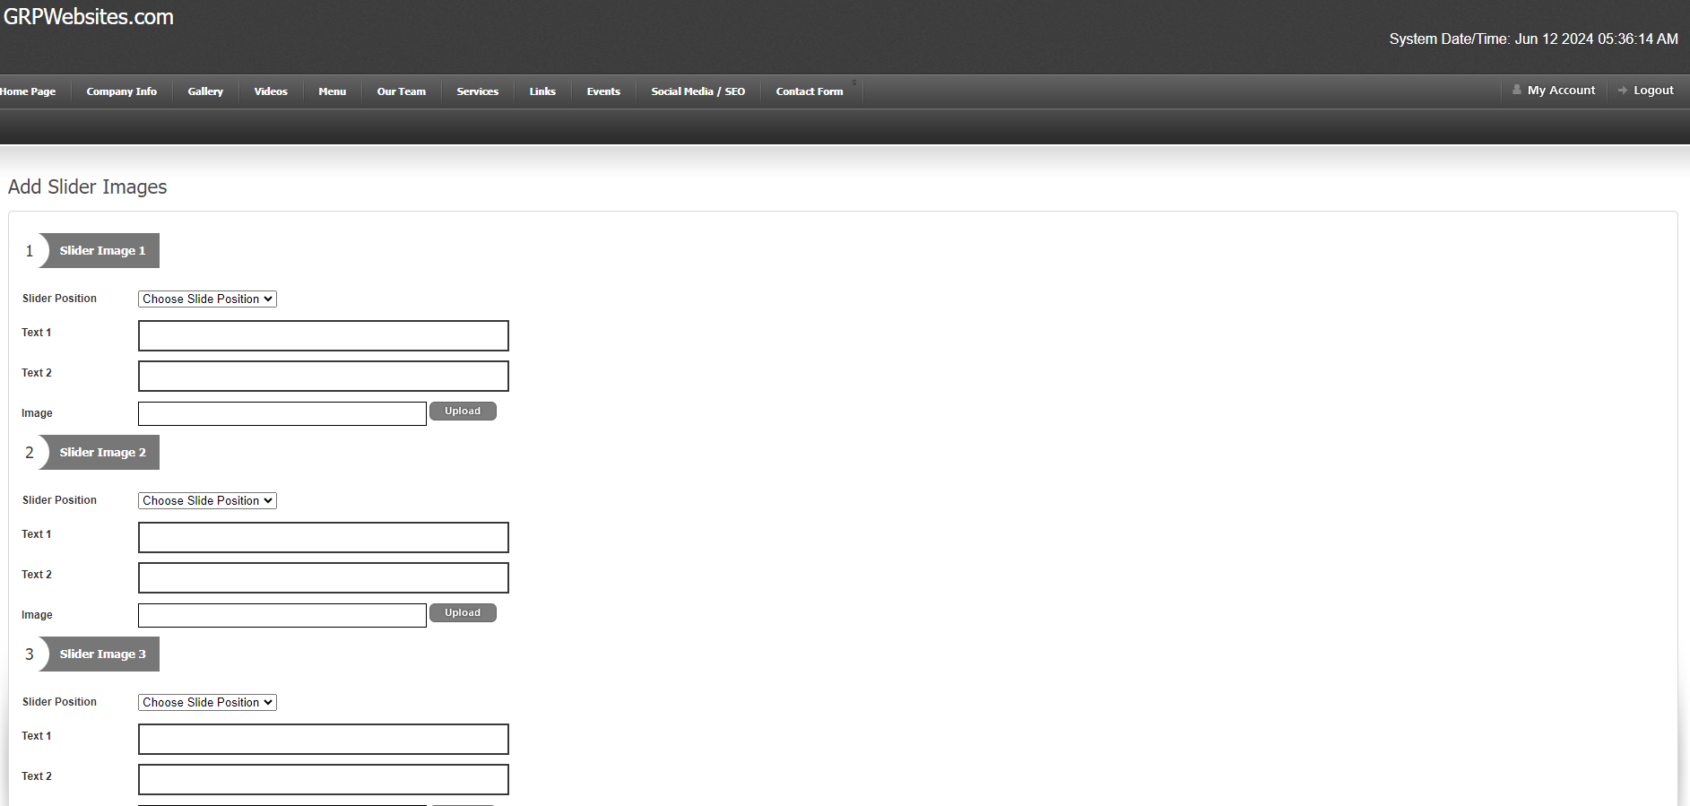
Home Page Slider

Slide 5
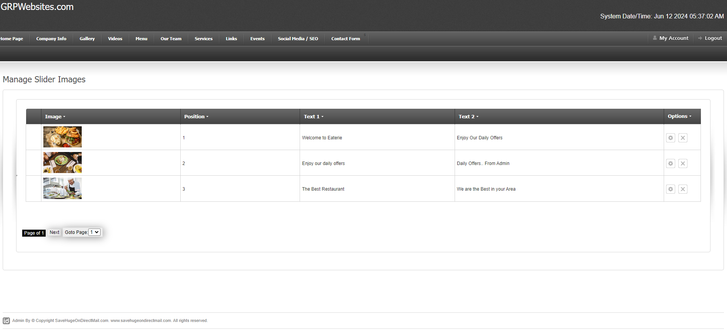
Edit/Delete Slider

Slide 6
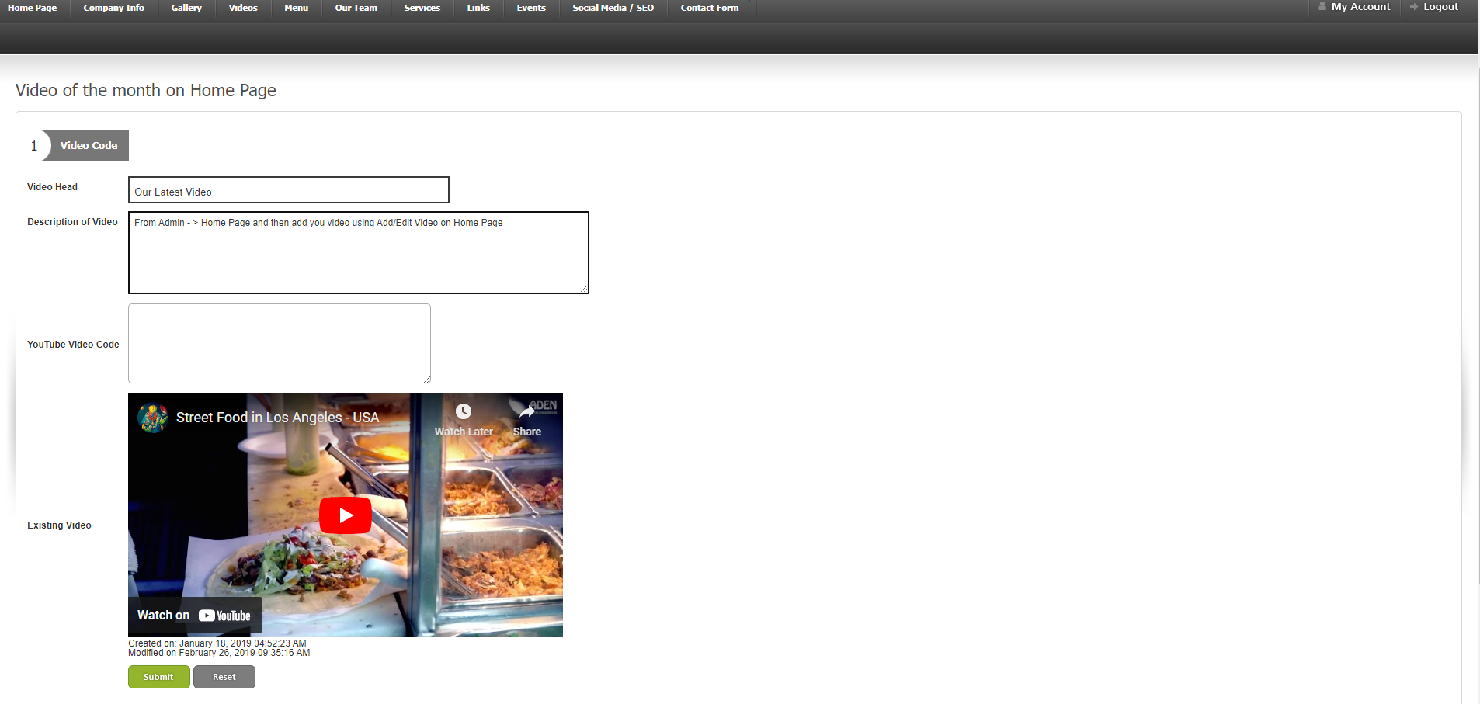
Add/Edit Homepage Videos.

Slide 7
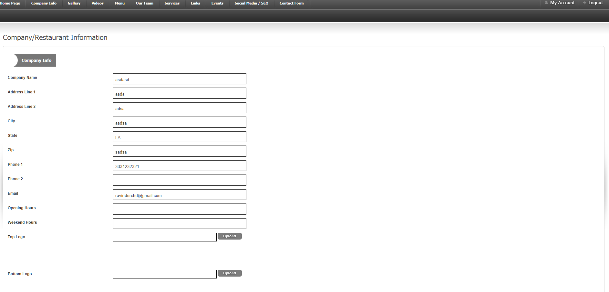
Company Information

Slide 8
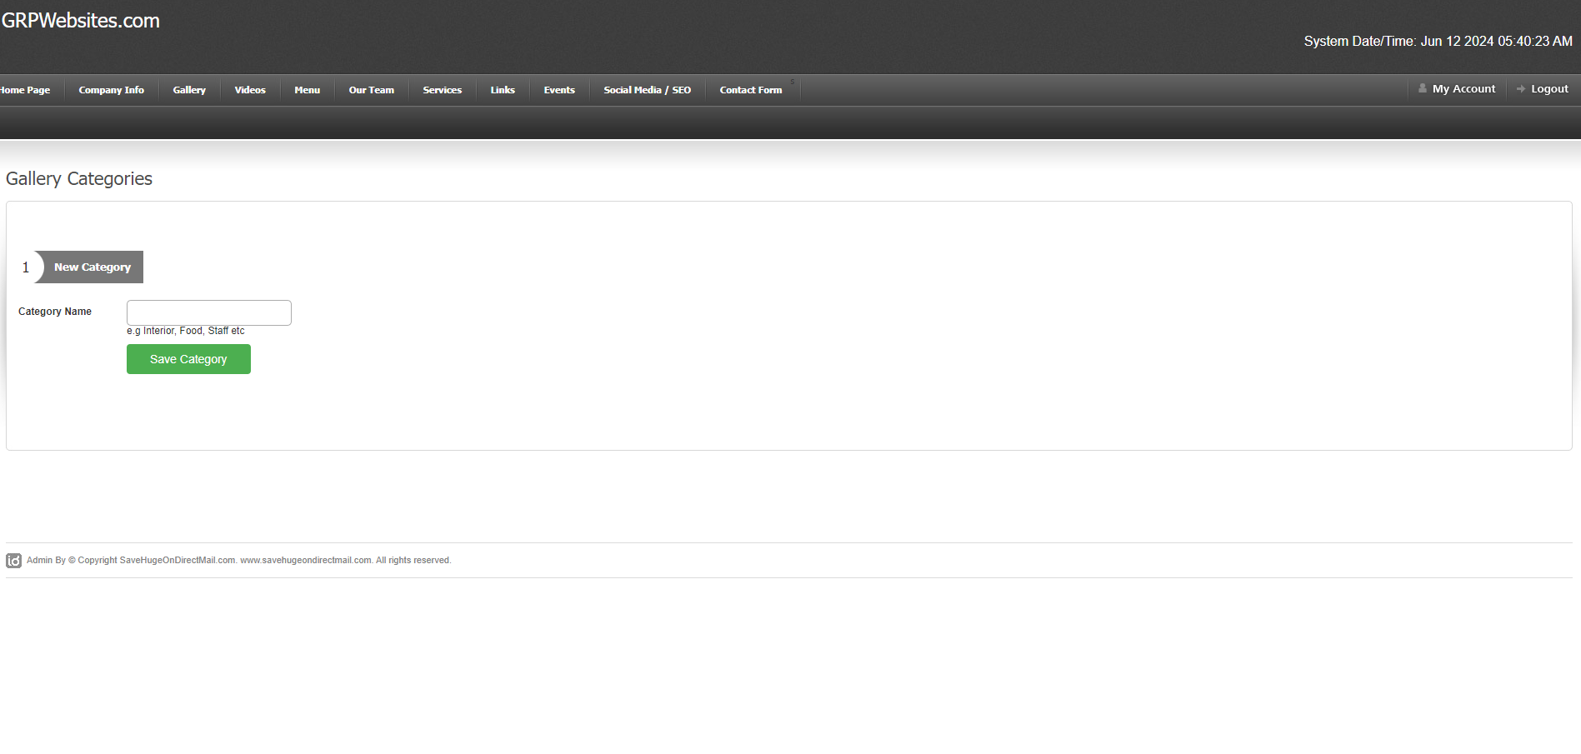
Add Gallery Categories

Slide 9
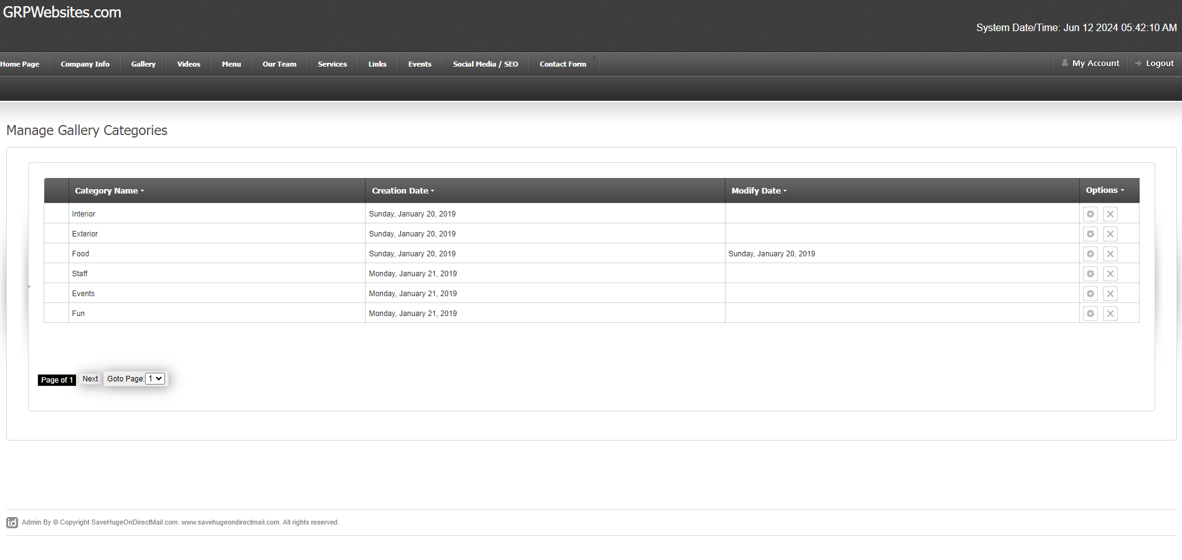
Manage Gallery Categories

Slide 10
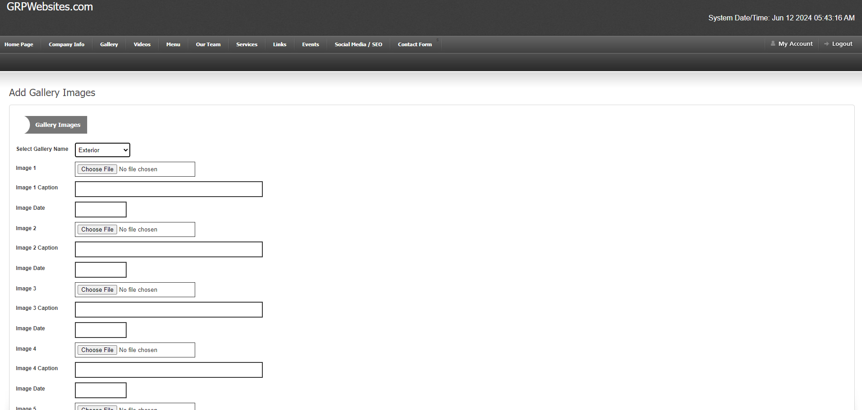
Add Images Under Galleries

Slide 11
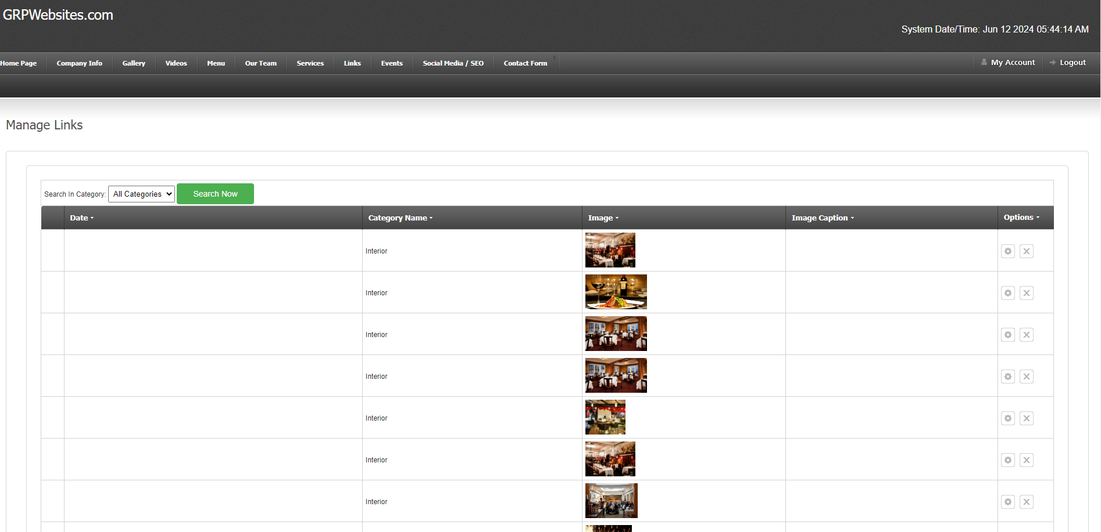
View Gallery Images

Slide 12
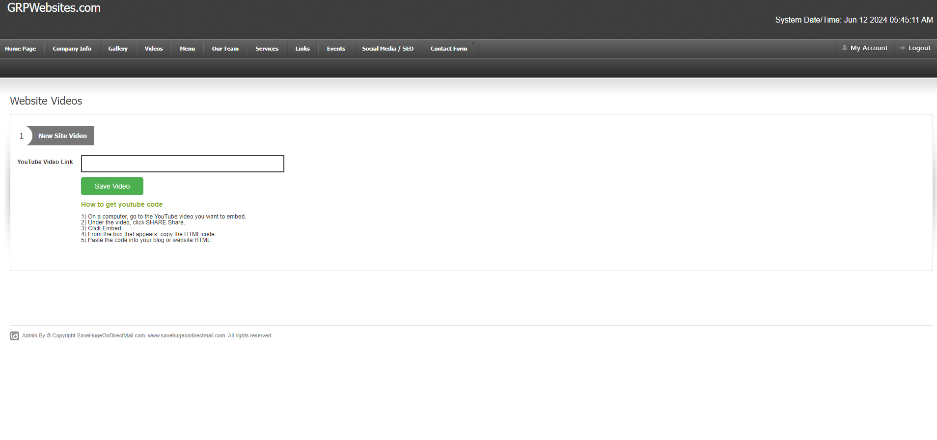
Add Videos Under Video Menu Link At the Top

Slide 13
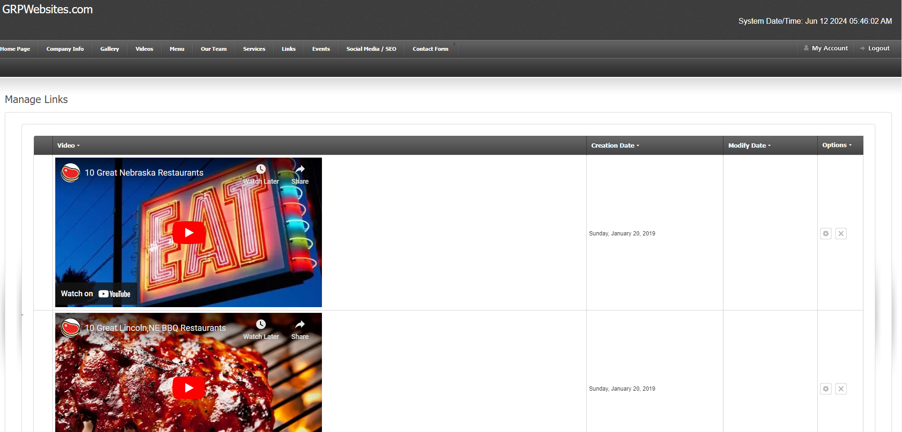
View/Edit/Delete Videos Under Video Link Of Website

Slide 14
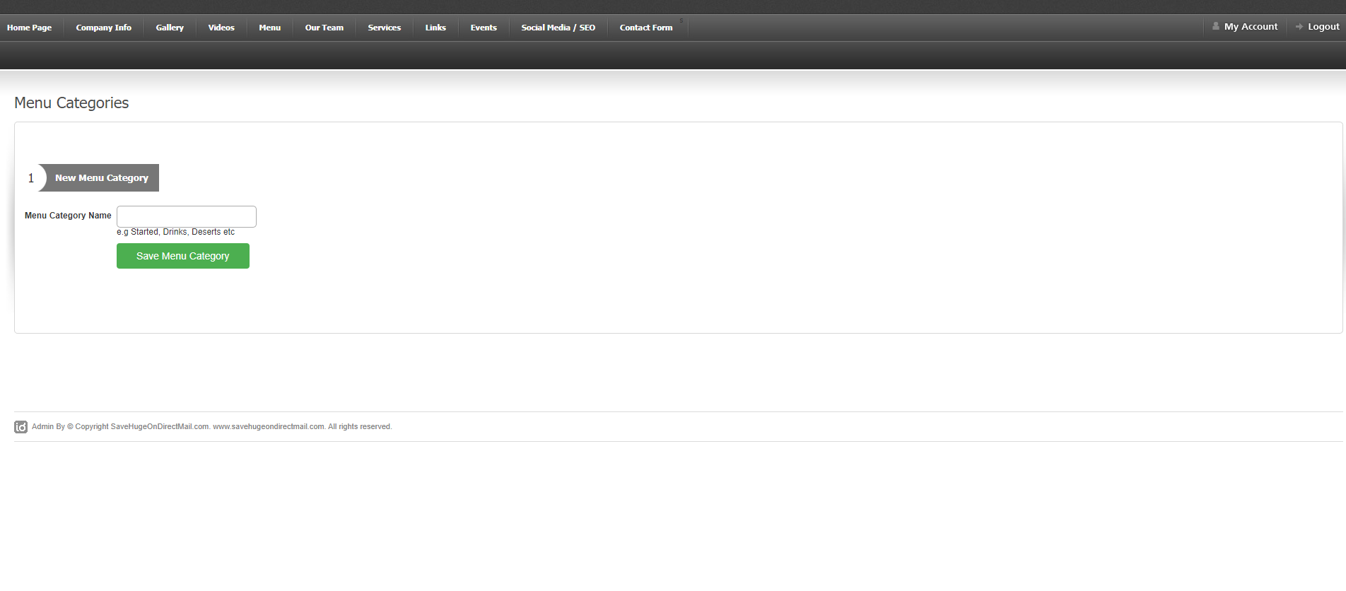
Add MENU Category

Slide 15
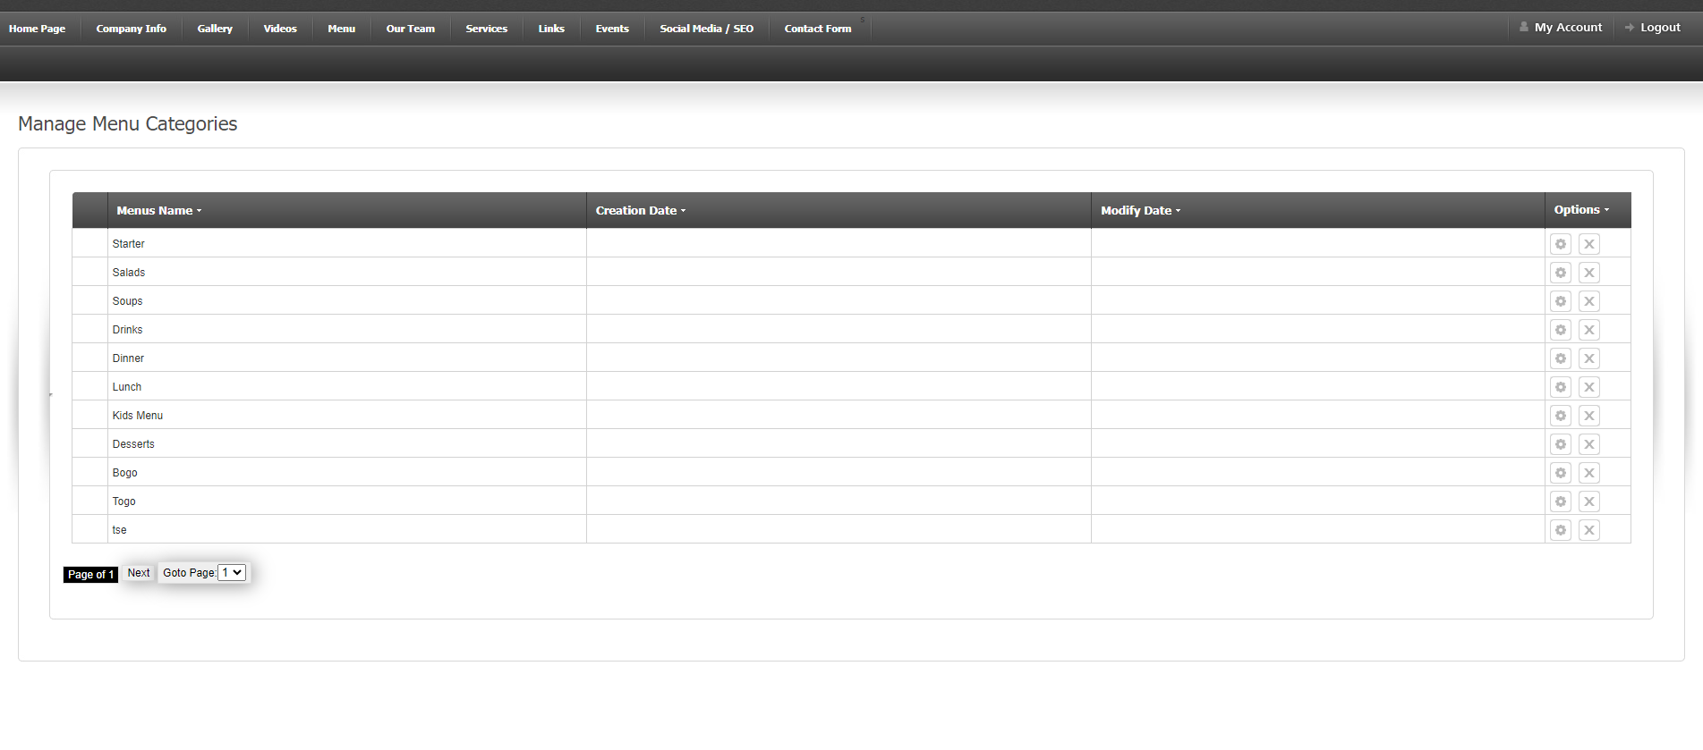
View/Edit/Delete Menu Categories

Slide 16
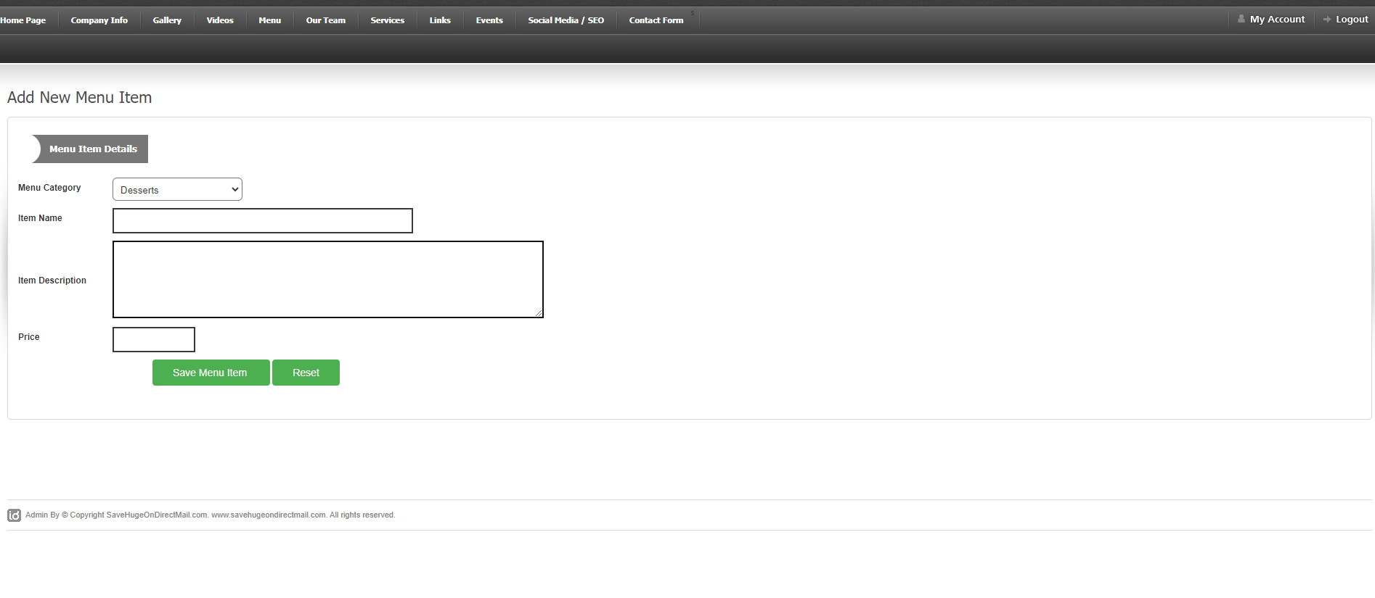
Adding Menu Item

Slide 17
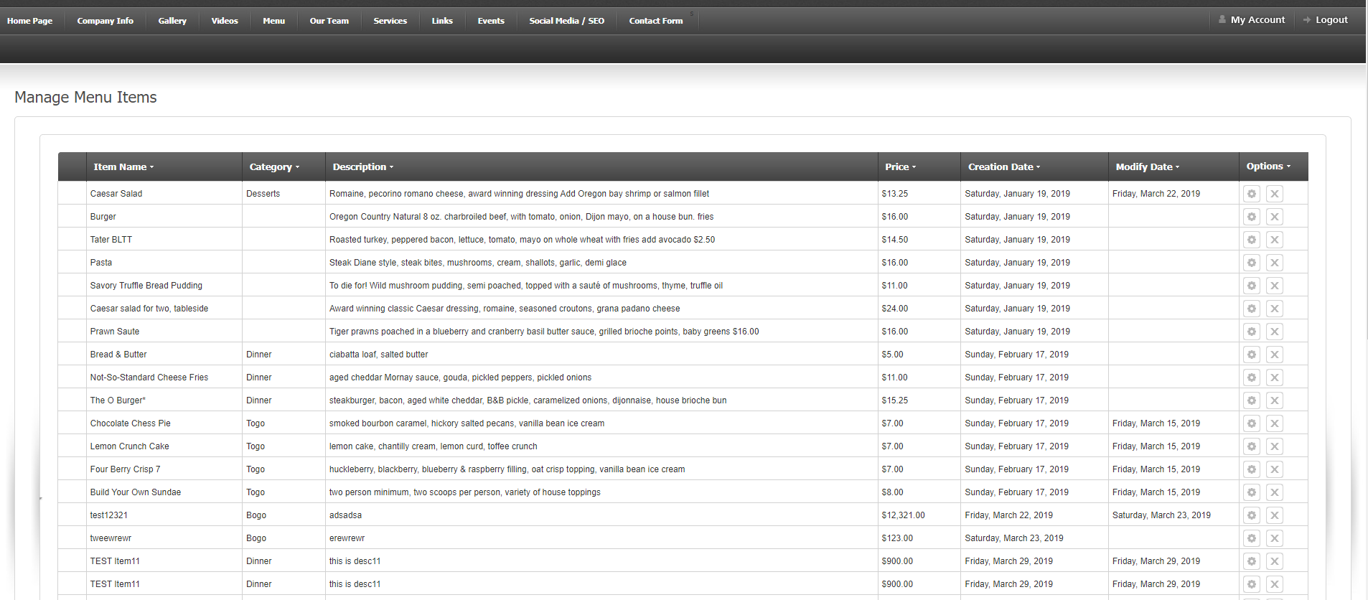
Manage/Edit/Delete Menu Items

Slide 18
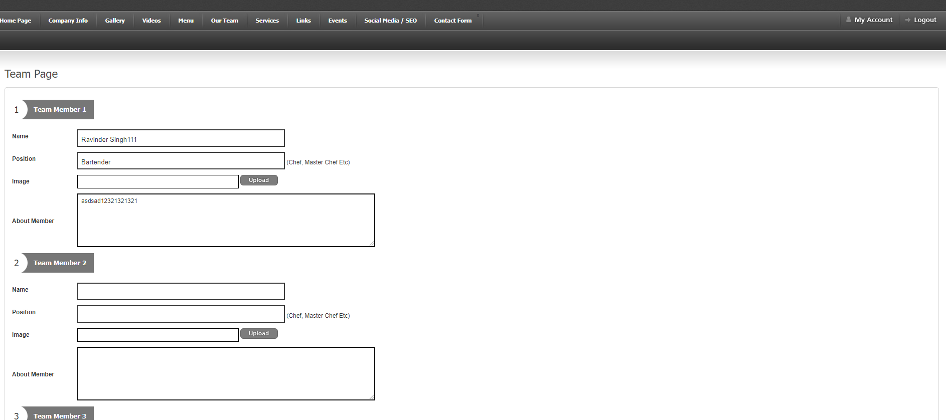
Matter for TEAM Link

Slide 19
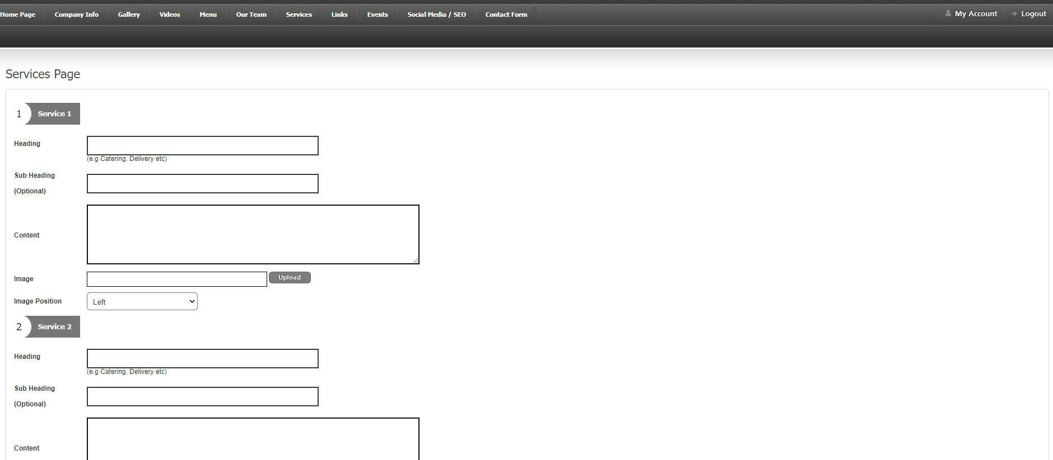
Contents For Service Link

Slide 20
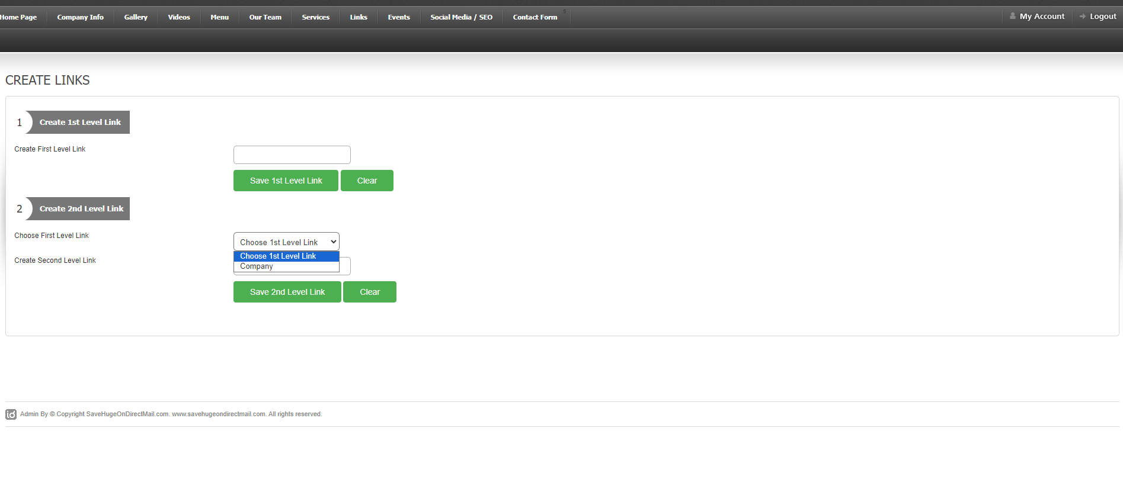
Create Other Link

Slide 21
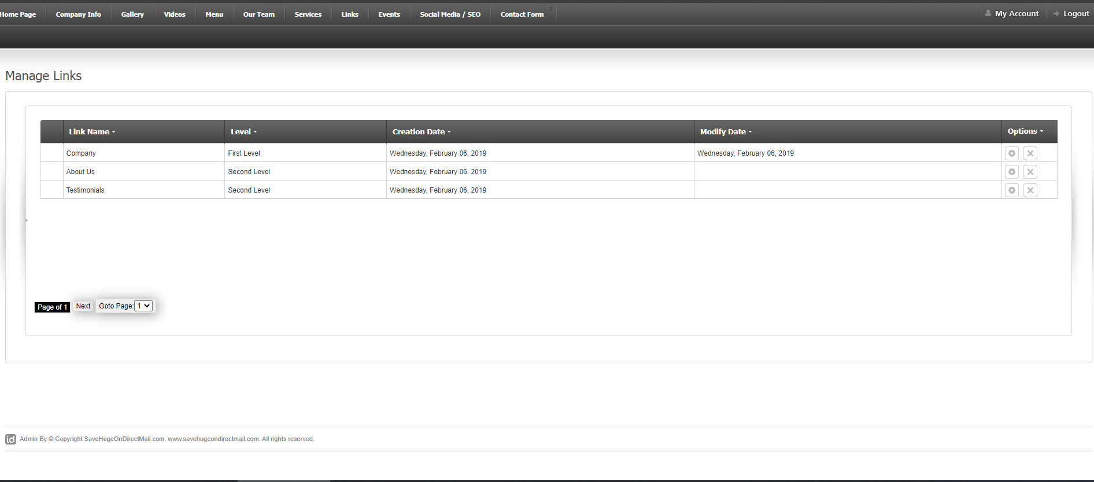
Manage Other Links

Slide 22
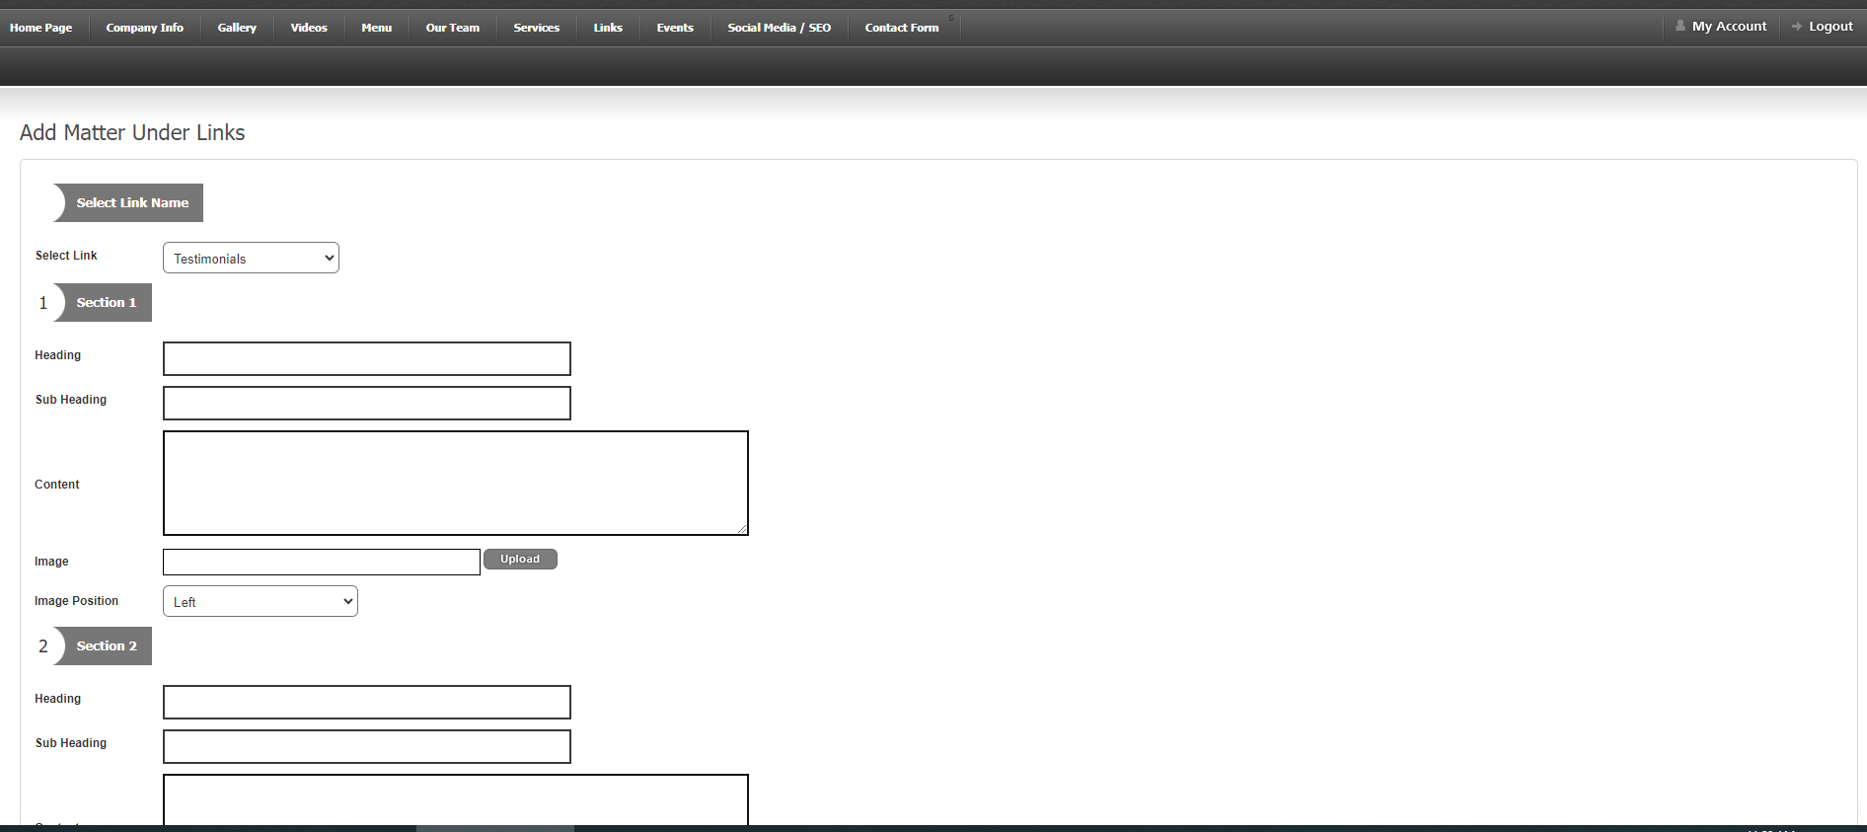
Add Link Matter

Slide 23
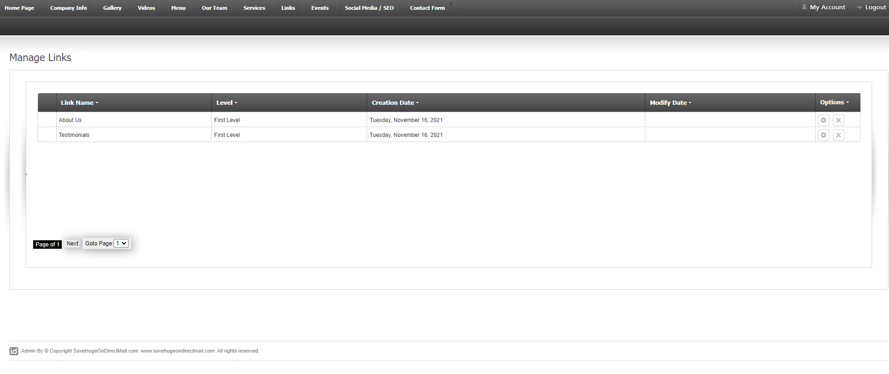
View Links

Slide 24
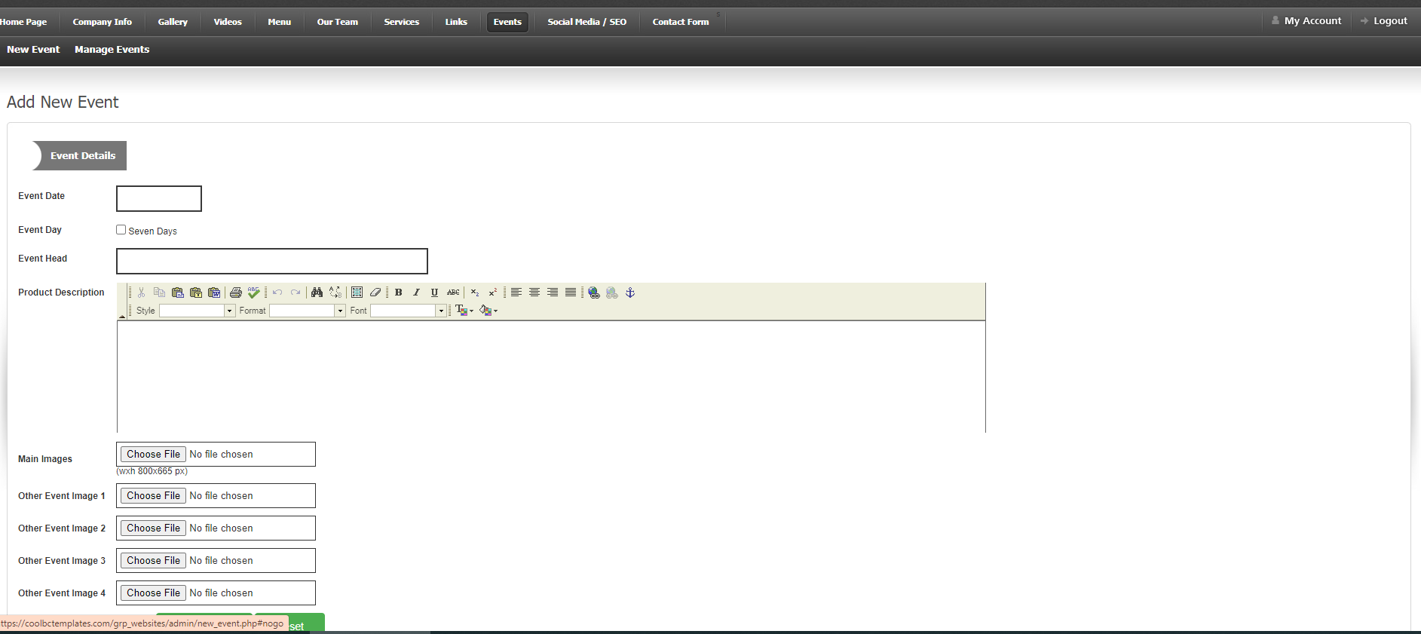
Add New Events for Event Link

Slide 25
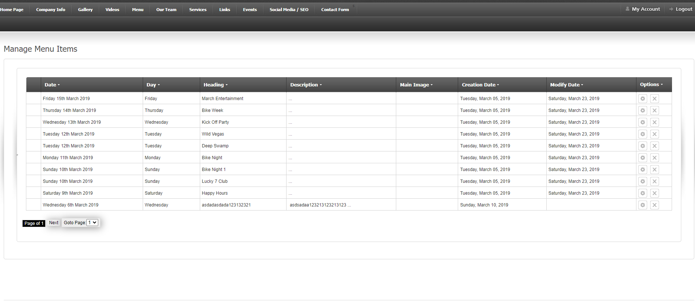
View Events

Slide 26
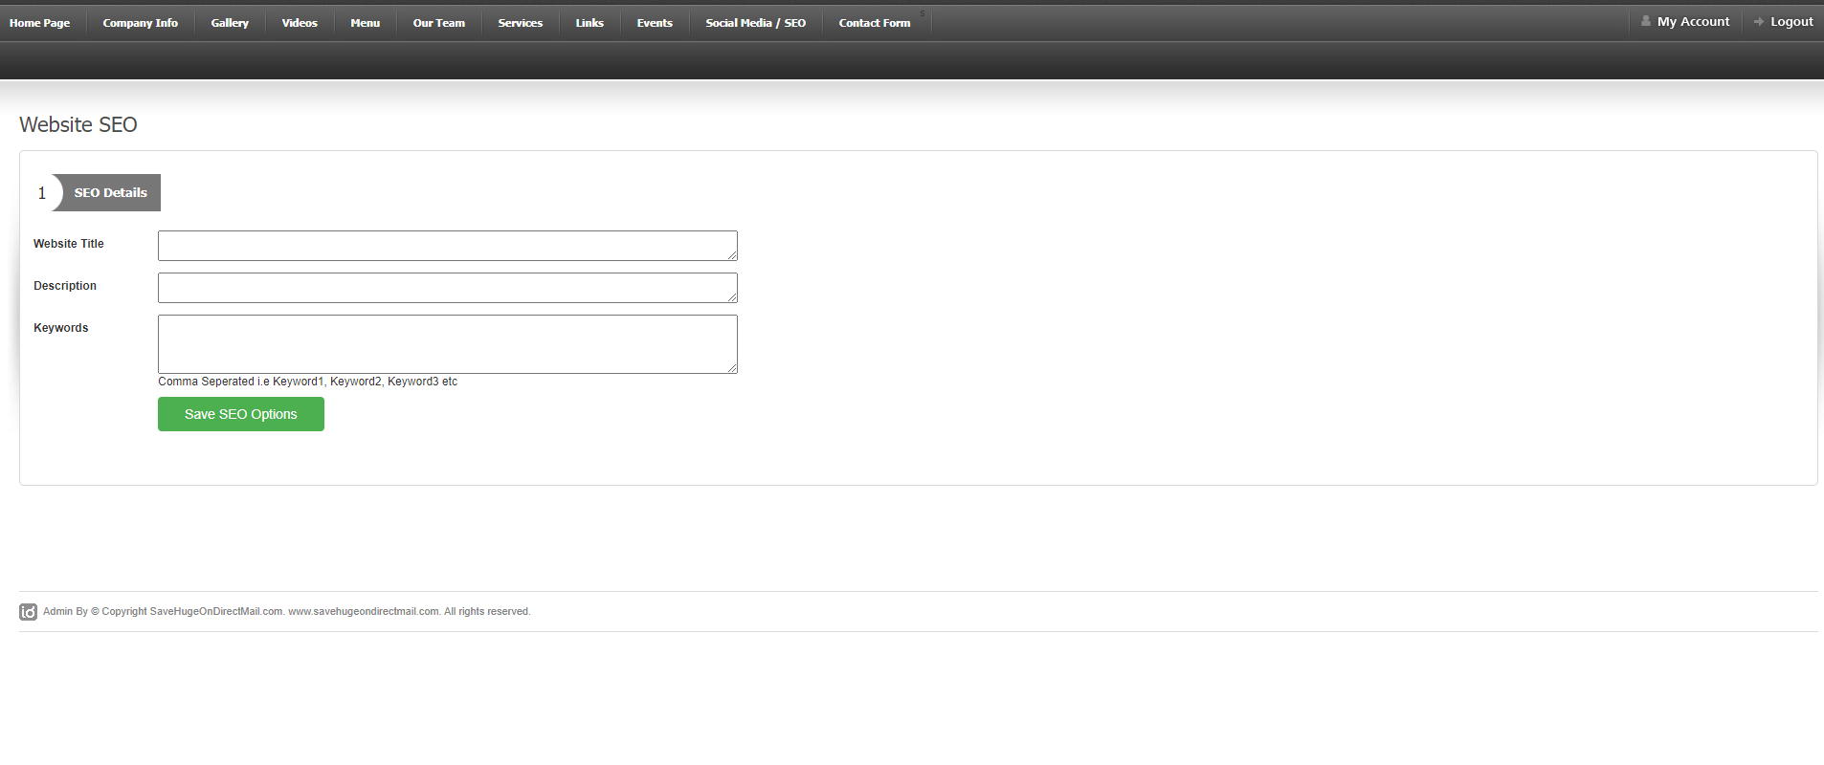
SEO Details

Slide 27
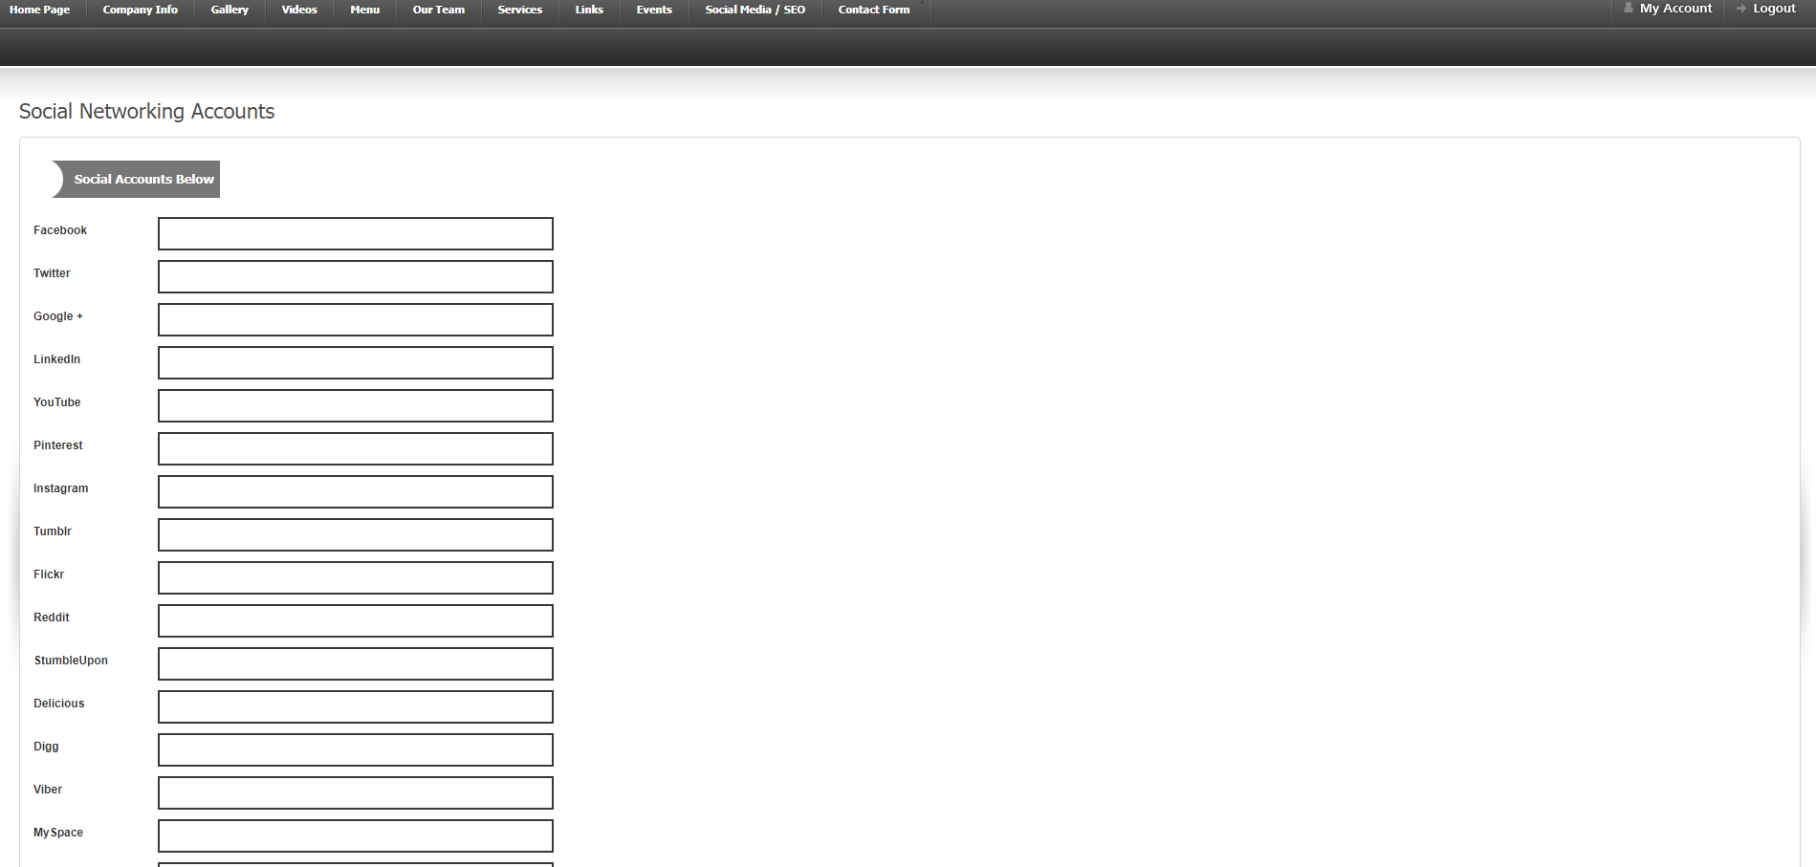
Social Media Accounts

Slide 28
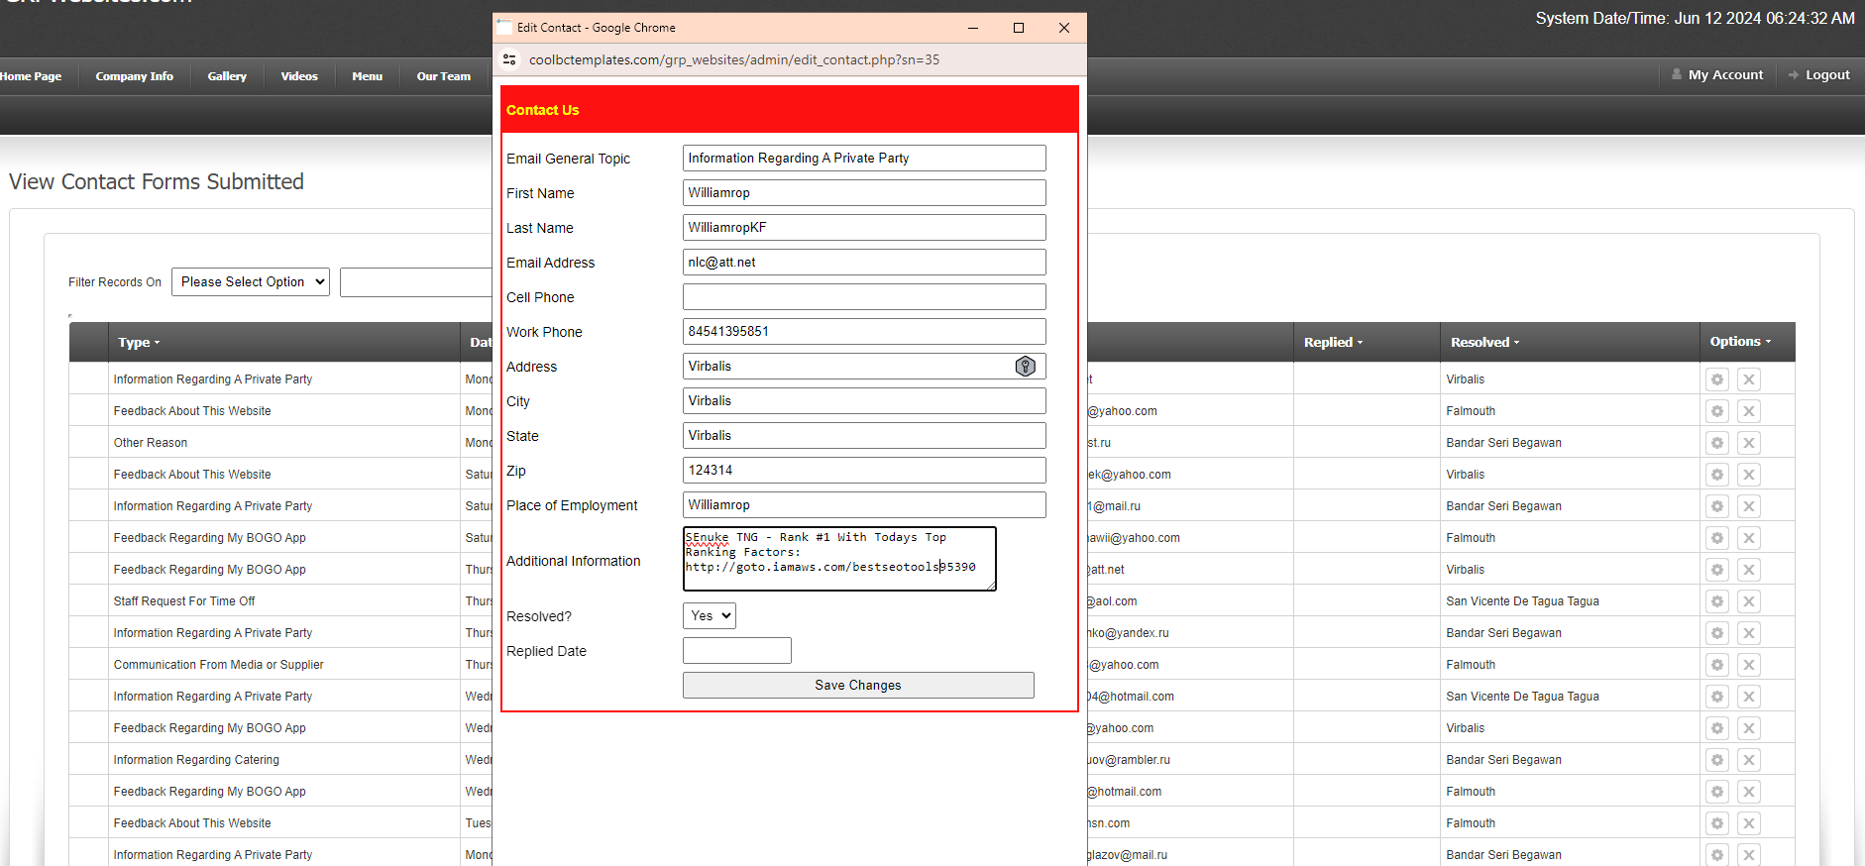
Contact Forms Filled

Slide 29
Website Front End Templates
Coming Soon

